Slide 1

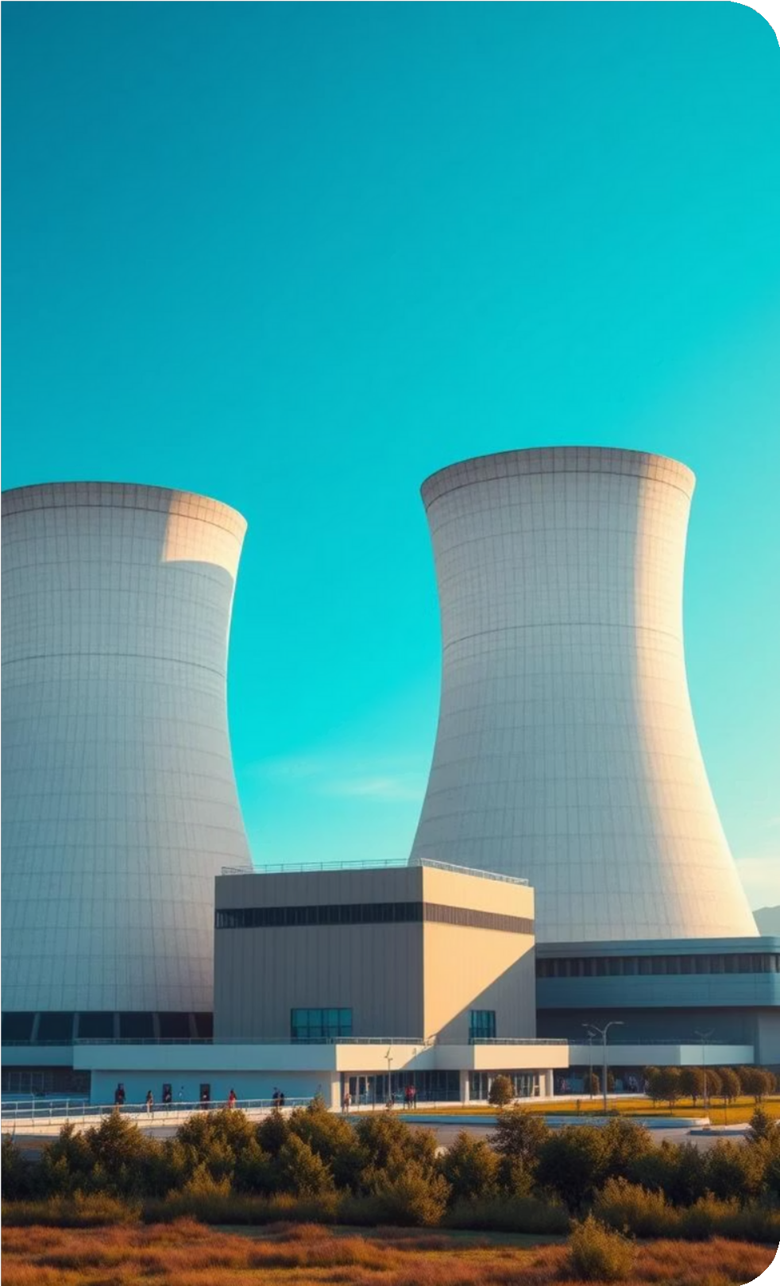
Is Nuclear Energy a Good Way to Fight Climate Change?
Name : Raiyan Mugdho ID:2211394042
Course: ENG 111 – Public Speaking
Date: 22nd November 2025

Slide 2

Climate Change: The Current Reality
Temperature Rise
Global temperature has increased 1.2°C since pre-industrial era
CO₂ Levels
420 ppm, highest in 3 million years
Annual Emissions
37 billion tons of CO₂ emitted annually
Fossil Fuels
Cause 75% of global emissions

Slide 3

Why Nuclear Energy Is Important
1
Zero-Carbon Electricity
Produces large-scale zero-carbon electricity
2
Continuous Power Generation
Generates power continuously, day and night
Energy Density
One uranium pellet = energy of 1 ton of coal
Global Safety Record
Already used safely in 30+ countries
3
4

Slide 4
12g
Scientific Evidence
820g
Coal Emissions
92%
Capacity Factor
Nuclear Emissions
CO₂ per kilowatt-hour (very low)
CO₂ per kilowatt-hour
Nuclear plants operate at this rate
*Next-generation reactors improve safety and stability

Slide 5

The Future: With vs. Without Nuclear
A Future WITH Nuclear Energy
A Future WITHOUT Nuclear Energy
Drastically lower carbon emissions
Stable, affordable electricity Real chance to reach net-zero
Increased dependence on fossil fuels Greater climate disasters
Higher global temperatures

Slide 6
Conclusion & Call to Action
Part of the Solution
Nuclear energy must be part of the climate solution
Strategic Investments
Investments in safe, advanced reactors are essential
Science-Based Understanding
Public understanding must be science-based
Diverse Clean Energy
A sustainable future requires diverse clean energy
sources, including nuclear

Slide 7
Thank You
"Clean energy choices define our future."

